Slide 1
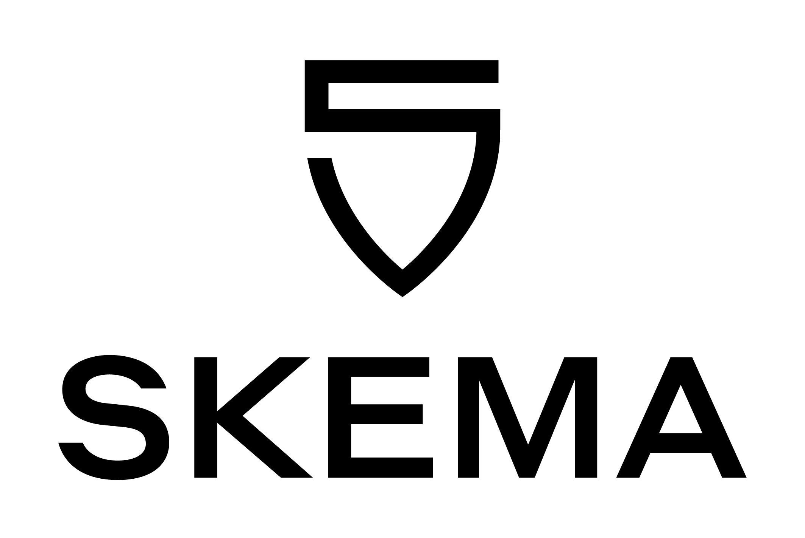
Capital Budgeting
Msc Corporate Financial Management
Lille Campus - 18 hours
Skema Business School
Step 5: Be careful with debt
" Financial Distress, Managerial Incentives, and Information "
Pr. Sébastien DEREEPER
Sebastien.Dereeper@skema.edu
Course Based on :
J. Berk & P. De Marzo - Corporate Finance - Pearson, 2024
Notes:
If this PowerPoint presentation contains mathematical equations, you may need to check that your computer has the following installed:
1) Math Type Plugin
2) Math Player (free versions available)
3) NVDA Reader (free versions available)

Slide 2
Outline (1 of 2)
1. Default and Bankruptcy in a Perfect Market
2. The Costs of Bankruptcy and Financial Distress
3. Financial Distress Costs and Firm Value
4. Optimal Capital Structure: The Tradeoff Theory
5. Exploiting Debt Holders: The Agency Costs of Leverage
6. Motivating Managers: The Agency Benefits of Leverage
7. Agency Costs and the Tradeoff Theory

Slide 3
Learning Objectives (1 of 3)
Describe the effect of bankruptcy in a world of perfect capital markets.
List and define two types of bankruptcy protection offered in the 1978 Bankruptcy Reform Act.
Discuss several direct and indirect costs of bankruptcy.

Slide 4
Learning Objectives (2 of 3)
Illustrate why, when securities are fairly priced, the original shareholders of a firm pay the present value of bankruptcy and financial distress costs.
Calculate the value of a levered firm in the presence of financial distress costs.
Define agency costs, and describe agency costs of financial distress and agency benefits of leverage.

Slide 5
Learning Objectives (3 of 3)
Calculate the value of the firm, including financial distress costs and agency costs.
Explain the impact of asymmetric information on the optimal level of leverage.
Describe the implications of adverse selection and the lemons principle for equity issuance; describe the empirical implications.

Slide 6
1. Default and Bankruptcy in a Perfect Market (1 of 2)
Financial Distress
  When a firm has difficulty meeting its debt obligations
Default
  When a firm fails to make the required interest or principal payments on its debt or violates a debt covenant
    After the firm defaults, debt holders are given certain rights to the assets of the firm and may even take legal ownership of the firm’s assets through bankruptcy

Slide 7
1. Default and Bankruptcy in a Perfect Market (2 of 2)
An important consequence of leverage is the risk of bankruptcy
  Equity financing does not carry this risk
  Although equity holders hope to receive dividends, the firm is not legally obligated to pay them

Slide 8
Armin Industries: Leverage and the Risk of Default (1 of 2)
Armin is considering a new project
  Although the new product represents a significant advance over Armin’s competitors’ products, the product’s success is uncertain
    If it is a hit, revenues and profits will grow, and Armin will be worth $150 million at the end of the year
    If it fails, Armin will be worth only $80 million

Slide 9
Armin Industries: Leverage and the Risk of Default (2 of 2)
Armin may employ one of two alternative capital structures:
  It can use all-equity financing
  It can use debt that matures at the end of the year with a total of $100 million due

Slide 10
Scenario 1: New Product Succeeds (1 of 3)
If the new product is successful, Armin is worth $150 million
  Without leverage, equity holders own the full amount.
  With leverage, Armin must make the $100 million debt payment, and Armin’s equity holders will own the remaining $50 million
    Even if Armin does not have $100 million in cash available at the end of the year, it will not be forced to default on its debt

Slide 11
Scenario 1: New Product Succeeds (2 of 3)
With perfect capital markets, as long as the value of the firm’s assets exceeds its liabilities, Armin will be able to repay the loan
  If it does not have the cash immediately available, it can raise the cash by obtaining a new loan or by issuing new shares

Slide 12
Scenario 1: New Product Succeeds (3 of 3)
If a firm has access to capital markets and can issue new securities at a fair price, then it need not default as long as the market value of its assets exceeds its liabilities
  Many firms experience years of negative cash flows yet remain solvent

Slide 13
Scenario 2: New Product Fails
If the new product fails, Armin is worth only $80 million.
  Without leverage, equity holders will lose $20 million
  With leverage, Armin will experience financial distress and the firm will default
    In bankruptcy, debt holders will receive legal ownership of the firm’s assets, leaving Armin’s shareholders with nothing
      Because the assets the debt holders receive have a value of $80 million, they will suffer a loss of $20 million

Slide 14
Comparing the Two Scenarios (1 of 3)
Both debt and equity holders are worse off if the product fails rather than succeeds
  Without leverage, if the product fails equity holders lose $70 million
  With leverage, equity holders lose $50 million, and debt holders lose $20 million, but the total loss is the same, $70 million

Slide 15
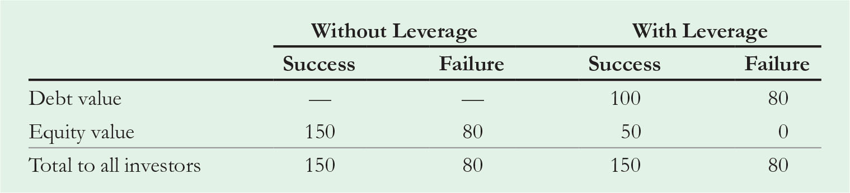
Table 1
Value of Debt and Equity with and without Leverage ($ Million)
Notes:
Long Description:
The table headers are without leverage: success and failure, with leverage: success and failure. The data listed row-wise are as follows: debt value, blank, blank, 100, 80; equity value, 150, 80, 50, 0; total to all investors, 150, 80, 150, 80.

Slide 16
Comparing the Two Scenarios (2 of 3)
If the new product fails, Armin’s investors are equally unhappy whether the firm is levered and declares bankruptcy or whether it is unlevered and the share price declines

Slide 17
Comparing the Two Scenarios (3 of 3)
Note, the decline in value is not caused by bankruptcy: The decline is the same whether or not the firm has leverage
  If the new product fails, Armin will experience economic distress, which is a significant decline in the value of a firm’s assets, whether or not it experiences financial distress due to leverage

Slide 18
Bankruptcy and Capital Structure
With perfect capital markets, Modigliani-Miller (M M) Proposition I applies: The total value to all investors does not depend on the firm’s capital structure
There is no disadvantage to debt financing, and a firm will have the same total value and will be able to raise the same amount initially from investors with either choice of capital structure

Slide 19
Example 1 (1 of 3)
Bankruptcy Risk and Firm Value
Problem
Suppose the risk-free rate is 5%, and Armin’s new product is equally likely to succeed or to fail. For simplicity, suppose that Armin’s cash flows are unrelated to the state of the economy (i.e., the risk is diversifiable), so that the project has a beta of 0 and the cost of capital is the risk-free rate. Compute the value of Armin’s securities at the beginning of the year with and without leverage, and show that M M
Proposition
holds.

Slide 20
Example 1 (2 of 3)
Solution
Without leverage, the equity is worth either $150 million or $80 million at year-end. Because the risk is diversifiable, no risk premium is necessary and we can discount the expected value of the firm at the risk-free rate to determine its value without leverage at the start of the year:
With leverage, equity holders receive $50 million or nothing, and debt holders receive $100 million or $80 million. Thus,
Notes:
Long Description:
Equity left parenthesis unlevered right parenthesis equals V superscript U baseline equals start fraction one-half left parenthesis 150 right parenthesis plus one-half left parenthesis 80 right parenthesis over 1.05 end fraction equals 109.52 million dollars.

Slide 21
Example 1 (3 of 3)
Therefore, the value of the levered firm is
With or without leverage, the total
value of the securities is the same, verifying M M proposition
The firm is able to raise the same amount from investors using either capital structure.

Slide 22
2. The Costs of Bankruptcy and Financial Distress
With perfect capital markets, the risk of bankruptcy is not a disadvantage of debt; rather, bankruptcy shifts the ownership of the firm from equity holders to debt holders without changing the total value available to all investors
  In reality, bankruptcy is rarely simple and straightforward. It is often a long and complicated process that imposes both direct and indirect costs on the firm and its investors

Slide 23
The Bankruptcy Code (1 of 4)
The U.S. bankruptcy code was created so that creditors are treated fairly and the value of the assets is not needlessly destroyed
  U.S. firms can file for two forms of bankruptcy protection: Chapter 7 or Chapter 11

Slide 24
The Bankruptcy Code (2 of 4)
Chapter 7 Liquidation
  A trustee is appointed to oversee the liquidation of the firm’s assets through an auction
  The proceeds from the liquidation are used to pay the firm’s creditors, and the firm ceases to exist

Slide 25
The Bankruptcy Code (3 of 4)
Chapter 11 Reorganization
  Chapter 11 is the more common form of bankruptcy for large corporations
  With Chapter 11, all pending collection attempts are automatically suspended, and the firm’s existing management is given the opportunity to propose a reorganization plan
    While developing the plan, management continues to operate the business
  The reorganization plan specifies the treatment of each creditor of the firm

Slide 26
The Bankruptcy Code (4 of 4)
Chapter 11 Reorganization
  Creditors may receive cash payments and/or new debt or equity securities of the firm
    The value of the cash and securities is typically less than the amount each creditor is owed but more than the creditors would receive if the firm were shut down immediately and liquidated
  The creditors must vote to accept the plan, and it must be approved by the bankruptcy court
  If an acceptable plan is not put forth, the court may ultimately force a Chapter 7 liquidation

Slide 27
Direct Costs of Bankruptcy (1 of 4)
The bankruptcy process is complex, time-consuming, and costly
  Costly outside experts are often hired by the firm to assist with the bankruptcy process
  Creditors also incur costs during the bankruptcy process
    They may wait several years to receive payment
    They may hire their own experts for legal and professional advice

Slide 28
Direct Costs of Bankruptcy (2 of 4)
The direct costs of bankruptcy reduce the value of the assets that the firm’s investors will ultimately receive
  The average direct costs of bankruptcy are approximately 3% to 4% of the pre-bankruptcy market value of total assets
  A study of Chapter 7 liquidations of small businesses found that the average direct costs of bankruptcy were 12% of the value of the firm’s assets

Slide 29
Direct Costs of Bankruptcy (3 of 4)
Given the direct costs of bankruptcy, firms may avoid filing for bankruptcy by first negotiating directly with creditors
Workout
  A method for avoiding bankruptcy in which a firm in financial distress negotiates directly with its creditors to reorganize
    The direct costs of bankruptcy should not substantially exceed the cost of a workout

Slide 30
Direct Costs of Bankruptcy (4 of 4)
Prepackaged Bankruptcy (Prepack)
  A method for avoiding many of the legal and other direct costs of bankruptcy in which a firm first develops a reorganization plan with the agreement of its main creditors and then files Chapter 11 to implement the plan
    With a prepackaged bankruptcy, the firm emerges from bankruptcy quickly and with minimal direct costs

Slide 31
Indirect Costs of Financial Distress
Although the indirect costs are difficult to measure accurately, they are often much larger than the direct costs of bankruptcy
  Loss of Customers
  Loss of Suppliers
  Loss of Employees
  Loss of Receivables
  Fire Sale of Assets
  Delayed Liquidation
  Costs to Creditors

Slide 32
Overall Impact of Indirect Costs (1 of 2)
The indirect costs of financial distress may be substantial
  It is estimated that the potential loss due to financial distress is 10% to 20% of firm value

Slide 33
Overall Impact of Indirect Costs (2 of 2)
When estimating indirect costs, two important points must be considered
  Losses to total firm value (and not solely losses to equity holders or debt holders or transfers between them) must be identified
  The incremental losses that are associated with financial distress, above and beyond any losses that would occur due to the firm’s economic distress, must be identified

Slide 34
3. Financial Distress Costs and Firm Value (1 of 3)
Armin Industries: The Impact of Financial Distress Costs
  With all-equity financing, Armin’s assets will be worth $150 million if its new product succeeds and $80 million if the new product fails

Slide 35
3. Financial Distress Costs and Firm Value (2 of 3)
Armin Industries: The Impact of Financial Distress Costs
  With debt of $100 million, Armin will be forced into bankruptcy if the new product fails
    In this case, some of the value of Armin’s assets will be lost to bankruptcy and financial distress costs.
    As a result, debt holders will receive less than $80 million
    Assume debt holders receive only $60 million after accounting for the costs of financial distress

Slide 36
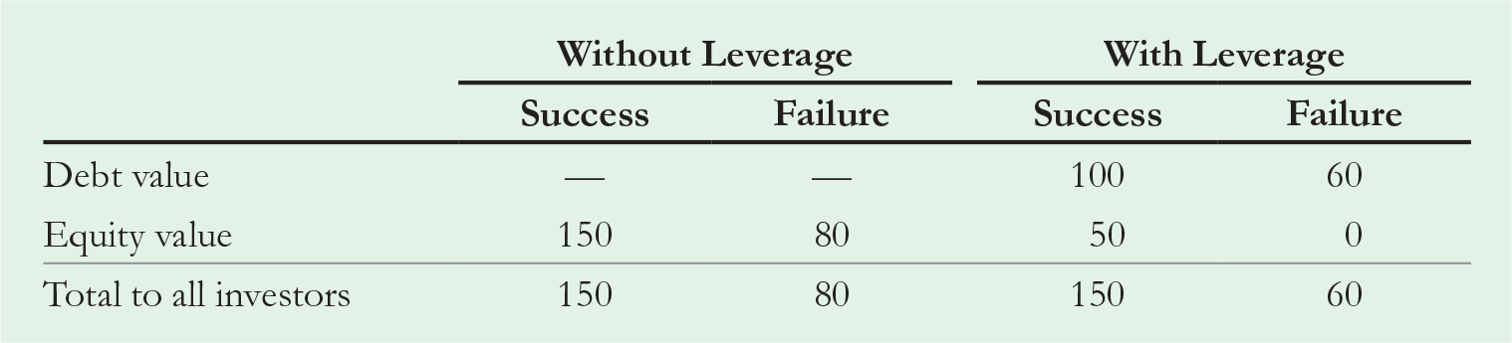
Table 2
Value of Debt and Equity with and Without Leverage (in $ Million)
Notes:
Long Description:
The columns are 1. without leverage: success and failure, and 2. with leverage: success and failure. The data listed row-wise are as follows: debt value: blank, blank, 100, 60; equity value, 150, 80, 50, 0; total to all investors, 150, 80, 150, 60.

Slide 37
3 Financial Distress Costs and Firm Value (3 of 3)
Armin Industries: The Impact of Financial Distress Costs
  As shown on the previous slide, the total value to all investors is now less with leverage than it is without leverage when the new product fails
    The difference of $20 million is due to financial distress costs
    These costs will lower the total value of the firm with
    leverage, and M M’s Proposition
    will no longer hold

Slide 38
Example 2 (1 of 3)
Firm Value When Financial Distress Is Costly
Problem
Compare the current value of Armin Industries with and without leverage, given the data in Table 2. Assume that the risk-free rate is 5%, the new product is equally likely to succeed or fail, and the risk is diversifiable.

Slide 39
Example 2 (2 of 3)
Solution
With and without leverage, the payments to equity holders are the same as in Example 1. There we computed the value of unlevered equity as $106.52 million and the value of levered equity as $23.81 million. But due to bankruptcy costs, the value of the debt is now

Slide 40
Example 2 (3 of 3)
The value of the levered firm is
which is less than the value of the unlevered firm,
Thus, due to bankruptcy costs, the value of the levered firm is $9.52 million less than its value without leverage. This loss equals the present value of the $20 million in financial distress costs the firm will pay if the product fails:

Slide 41
Who Pays for Financial Distress Costs? (1 of 3)
For Armin, if the new product fails, equity holders lose their investment in the firm and will not care about bankruptcy costs
However, debt holders recognize that if the new product fails and the firm defaults, they will not be able to get the full value of the assets
  As a result, they will pay less for the debt initially (the present value of the bankruptcy costs less)

Slide 42
Who Pays for Financial Distress Costs? (2 of 3)
If the debt holders initially pay less for the debt, less money is available for the firm to pay dividends, repurchase shares, and make investments
  This difference comes out of the equity holders’ pockets

Slide 43
Who Pays for Financial Distress Costs? (3 of 3)
When securities are fairly priced, the original shareholders of a firm pay the present value of the costs associated with bankruptcy and financial distress

Slide 44
4. Optimal Capital Structure: The Tradeoff Theory (1 of 2)
Tradeoff Theory
  The firm picks its capital structure by trading off the benefits of the tax shield from debt against the costs of financial distress and agency costs

Slide 45
4. Optimal Capital Structure: The Tradeoff Theory (2 of 2)
According to the Tradeoff theory, the total value of a levered firm equals the value of the firm without leverage plus the present value of the tax savings from debt, less the present value of financial distress costs:

Slide 46
The Present Value of Financial Distress Costs (1 of 3)
Three key factors determine the present value of financial distress costs:
The probability of financial distress
  The probability of financial distress increases with the amount of a firm’s liabilities (relative to its assets)
  The probability of financial distress increases with the volatility of a firm’s cash flows and asset values

Slide 47
The Present Value of Financial Distress Costs (2 of 3)
Three key factors determine the present value of financial distress costs:
The magnitude of the costs after a firm is in distress
  Financial distress costs will vary by industry
    Technology firms will likely incur high financial distress costs due to the potential for loss of customers and key personnel, as well as a lack of tangible assets that can be easily liquidated
    Real estate firms are likely to have low costs of financial distress because the majority of their assets can be sold relatively easily

Slide 48
The Present Value of Financial Distress Costs (3 of 3)
Three key factors determine the present value of financial distress costs:
The appropriate discount rate for the distress costs
  Depends on the firm’s market risk
    Note that because distress costs are high when the firm does poorly, the beta of distress costs has the opposite sign to that of the firm
    The higher the firm’s beta, the more negative the beta of its distress costs will be
  The present value of distress costs will be higher for high beta firms

Slide 49
Optimal Leverage (1 of 4)
For low levels of debt, the risk of default remains low, and the main effect of an increase in leverage is an increase in the interest tax shield

Slide 50
Optimal Leverage (2 of 4)
As the level of debt increases, the probability of default increases
  As the level of debt increases, the costs of financial distress increase, reducing the value of the levered firm

Slide 51
Optimal Leverage (3 of 4)
The Tradeoff theory states that firms should increase their leverage until it reaches the level for which the firm value is maximized
  At this point, the tax savings that result from increasing leverage are perfectly offset by the increased probability of incurring the costs of financial distress

Slide 52
Optimal Leverage (4 of 4)
The Tradeoff theory can help explain
  Why firms choose debt levels that are too low to fully exploit the interest tax shield (due to the presence of financial distress costs)
  Differences in the use of leverage across industries (due to differences in the magnitude of financial distress costs and the volatility of cash flows)

Slide 53
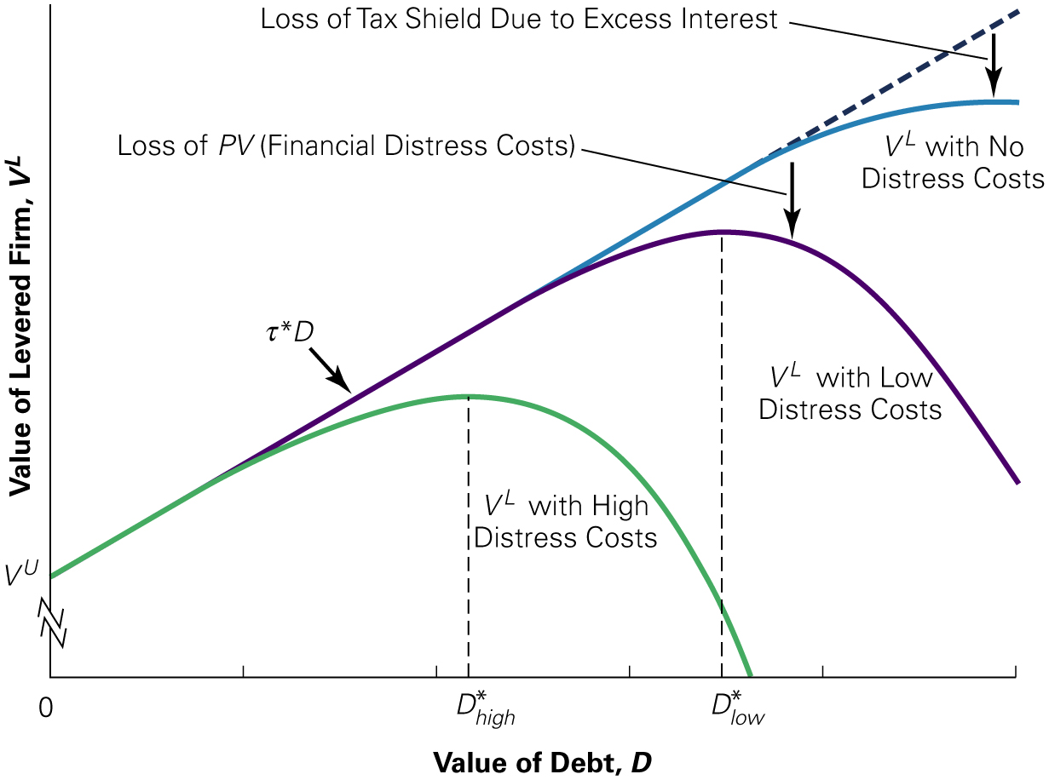
Figure 1
Optimal Leverage with Taxes and Financial Distress Costs
Notes:
Long Description:
The details of the graph are as follows: The x-axis shows the value of debt, D. The y-axis shows the value of levered firm, V super L. The plot for V super U is a line rising through (0, V super U) marked tau start super D. The plots for V super L with high and low distress costs both rise along the bottom of the line, before peaking below it. The plot for V super L with high distress costs peaks at D-star sub high, and the plot for V super L with low distress costs has a higher peak at D-star sub low. The vertical distance between the line and the curve represents the loss of P V, or financial distress costs.

Slide 54
Example 3 (1 of 2)
Choosing an Optimal Debt Level
Problems
Greenleaf Industries is considering adding leverage to its capital structure. Greenleaf’s managers believe they can add as much as $35 million in debt and exploit the benefits of the tax shield (for which they
estimate
However, they also recognize that higher debt
increases the risk of financial distress. Based on simulations of the firm’s future cash flows, the C F O has made the following estimates (in millions of dollars):
Debt | 0 | 10 | 20 | 25 | 30 | 35
PV (Interest tax shield) | 0 point 0 0 | 1 point 5 0 | 3 point 0 0 | 3.75 | 4 point 5 0 | 5.25
PV (Financial distress costs) | 0 point 0 0 | 0 point 0 0 | 0.38 | 1.62 | 4 point 0 0 | 6.38
What is the optimal debt choice for Greenleaf?

Slide 55
Example 3 (2 of 2)
Solution
From Equation, the net benefit of debt is determined by subtracting P V (Financial distress costs) from P V (Interest tax shield). The net benefit for each level of debt is
Debt | 0 | 10 | 20 | 25 | 30 | 35
Net Benefit | 0 point 0 0 | 1 point 5 0 | 2.62 | 2.13 | 4 point 5 0 | −1.13
The level of debt that leads to the highest net benefit is $20 million. Greenleaf will gain $3 million due to tax shields, and lose $0.38 million due to the present value of distress costs, for a net gain of $2.62 million.

Slide 56
5. Exploiting Debt Holders: The Agency Costs of Leverage (1 of 2)
Agency Costs
  Costs that arise when there are conflicts of interest between the firm’s stakeholders
Management will generally make decisions that increase the value of the firm’s equity
  However, when a firm has leverage, managers may make decisions that benefit shareholders but harm the firm’s creditors and lower the total value of the firm

Slide 57
5. Exploiting Debt Holders: The Agency Costs of Leverage (2 of 2)
Consider Baxter, Inc., which is facing financial distress
  Baxter has a loan of $1 million due at the end of the year
  Without a change in its strategy, the market value of its assets will be only $900,000 at that time, and Baxter will default on its debt

Slide 58
Excessive Risk-Taking and Asset Substitution (1 of 8)
Baxter is considering a new strategy
  The new strategy requires no upfront investment, but it has only a 50% chance of success

Slide 59
Excessive Risk-Taking and Asset Substitution (2 of 8)
If the new strategy succeeds, it will increase the value of the firm’s asset to $1.3 million
If the new strategy fails, the value of the firm’s assets will fall to $300,000

Slide 60
Excessive Risk-Taking and Asset Substitution (3 of 8)
The expected value of the firm’s assets under the new strategy is $800,000, a decline of $100,000 from the old strategy
Despite the negative expected payoff, some within the firm have suggested that Baxter should go ahead with the new strategy
  Can shareholders benefit from this decision?

Slide 61
Excessive Risk-Taking and Asset Substitution (4 of 8)
If Baxter does nothing, it will ultimately default and equity holders will get nothing with certainty
  Equity holders have nothing to lose if Baxter tries the risky strategy
If the strategy succeeds, equity holders will receive $300,000 after paying off the debt
  Given a 50% chance of success, the equity holders’ expected payoff is $150,000

Slide 62
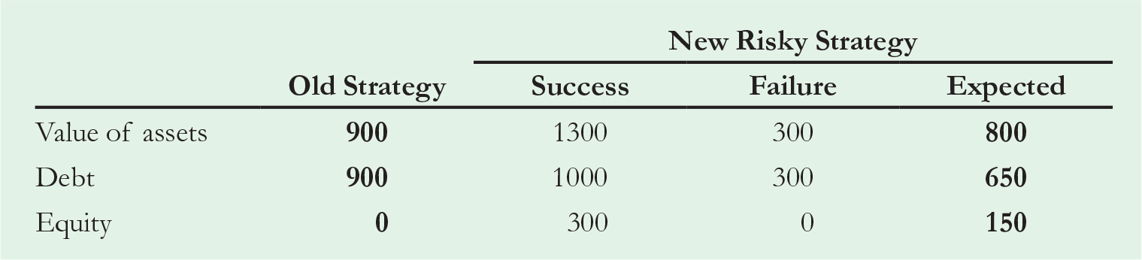
Table 3
Outcomes for Baxter’s Debt and Equity under Each Strategy ($ thousand)
Notes:
Long Description:
The table headers are old strategy; new risky strategy: success, failure, and expected. The data listed row-wise are as follows: value of assets: 900, 1300, 300, 800; debt: 900, 1000, 300, 650; equity: 0, 300, 0, 150.

Slide 63
Excessive Risk-Taking and Asset Substitution (5 of 8)
Equity holders gain from this strategy, even though it has a negative expected payoff, while debt holders lose
  If the project succeeds, debt holders are fully repaid and receive $1 million
  If the project fails, debt holders receive only $300,000.
    The debt holders’ expected payoff is $650,000, a loss of $250,000 compared to the old strategy

Slide 64
Excessive Risk-Taking and Asset Substitution (6 of 8)
The debt holders $250,000 loss corresponds to the $100,000 expected decline in firm value due to the risky strategy and the equity holder’s $150,000 gain
Effectively, the equity holders are gambling with the debt holders’ money

Slide 65
Excessive Risk-Taking and Asset Substitution (7 of 8)
Asset Substitution Problem
  When a firm faces financial distress, shareholders can gain at the expense of debt holders by taking a negative-N P V project, if it is sufficiently risky

Slide 66
Excessive Risk-Taking and Asset Substitution (8 of 8)
Shareholders have an incentive to invest in negative-N P V projects that are risky, even though a negative-N P V project destroys value for the firm overall
  Anticipating this bad behavior, security holders will pay less for the firm initially

Slide 67
Debt Overhang and Under-Investment (1 of 5)
Now assume Baxter does not pursue the risky strategy, but instead the firm is considering an investment opportunity that requires an initial investment of $100,000 and will generate a risk-free return of 50%

Slide 68
Debt Overhang and Under-Investment (2 of 5)
If the current risk-free rate is 5%, this investment clearly has a positive N P V
  What if Baxter does not have the cash on hand to make the investment?
  Could Baxter raise $100,000 in new equity to make the investment?

Slide 69
Table 4
Outcomes for Baxter’s Debt and Equity with and without the New Project (in $ thousand)
Blank | Without New Project | With New Project
Existing assets | 900 | 900
New project | Blank | 150
Total firm value | 900 | 1050
Debt | 900 | 1000
Equity | 0 | 50

Slide 70
Debt Overhang and Under-Investment (3 of 5)
If equity holders contribute $100,000 to fund the project, they get back only $50,000
  The other $100,000 from the project goes to the debt holders, whose payoff increases from $900,000 to $1 million
  The debt holders receive most of the benefit, thus this project is a negative-N P V investment opportunity for equity holders, even though it offers a positive N P V for the firm

Slide 71
Debt Overhang and Under-Investment (4 of 5)
Debt Overhang or Under-Investment Problem
  A situation in which equity holders choose not to invest in a positive N P V project because the firm is in financial distress and the value of undertaking the investment opportunity will accrue to bondholders rather than themselves

Slide 72
Debt Overhang and Under-Investment (5 of 5)
When a firm faces financial distress, it may choose not to finance new, positive-N P V projects
This is also called a debt overhang problem

Slide 73
Cashing Out
When a firm faces financial distress, shareholders have an incentive to withdraw money from the firm, if possible
  For example, if it is likely the company will default, the firm may sell assets below market value and use the funds to pay an immediate cash dividend to the shareholders
    This is another form of under-investment that occurs when a firm faces financial distress

Slide 74
Estimating the Debt Overhang
How much leverage must a firm have for there to be a significant debt overhang problem?
Suppose equity holders invest an amount I in a new investment with similar risk to the rest of the firm
Equity holders will benefit from the new investment only if

Slide 75
Example 4 (1 of 2)
Estimating the Debt Overhang
Problem
In Example 12.7, we estimated that Sears had an equity beta of 1.36, a debt beta of 0.17, and a debt-equity ratio of
while Saks had an equity beta of 1.85, a debt beta of
0.31, and a debt-equity ratio of
For both firms, estimate
the minimum N P V such that a new $100,000 investment (which does not change the volatility of the firm) will benefit shareholders. Which firm has the more severe debt overhang?

Slide 76
Example 4 (2 of 2)
Solution
We can use Equation to estimate the cutoff level of the
profitability index for Sears as
Thus, the N P V would need to equal at least $3750 for the investment to benefit shareholders. For Saks, the cutoff is
Thus, the minimum N P V for Saks
$16,750. Saks has the more severe debt overhang, as its shareholders will reject projects with positive N P Vs up to this higher cutoff. Similarly, Saks shareholders would benefit if the firm “cashed out” by liquidating up to $116,750 worth of assets to pay out an additional $100,000 in dividends.

Slide 77
Agency Costs and the Value of Leverage (1 of 4)
Leverage can encourage managers and shareholders to act in ways that reduce firm value
  It appears that the equity holders benefit at the expense of the debt holders
  However, ultimately, it is the shareholders of the firm who bear these agency costs

Slide 78
Agency Costs and the Value of Leverage (2 of 4)
When a firm adds leverage to its capital structure, the decision has two effects on the share price
  The share price benefits from equity holders’ ability to exploit debt holders in times of distress

Slide 79
Agency Costs and the Value of Leverage (3 of 4)
When a firm adds leverage to its capital structure, the decision has two effects on the share price
  The debt holders recognize this possibility and pay less for the debt when it is issued, reducing the amount the firm can distribute to shareholders
    Debt holders lose more than shareholders gain from these activities, and the net effect is a reduction in the initial share price of the firm

Slide 80
Agency Costs and the Value of Leverage (4 of 4)
Agency costs of debt represent another cost of increasing the firm’s leverage that will affect the firm’s optimal capital structure choice

Slide 81
Example 5 (1 of 3)
Agency Costs and the Amount of Leverage
Problem
Would the agency costs described previously arise if Baxter had less leverage and owed $400,000 rather than $1 million?

Slide 82
Example 5 (2 of 3)
Solution
If Baxter makes no new investments or changes to its strategy, the firm will be worth $900,000. Thus, the firm will remain solvent and its equity
will be worth
Consider first the decision
to increase risk. If Baxter takes the risky strategy, its assets will be worth either $1.3 million or $300,000, so equity holders will receive $900,000 or $0. In this case, the equity holders’ expected payoff with the risky project
is only
Thus equity holders will reject the
risky strategy.
What about under-investment? If Baxter raises $100,000 from equity holders to fund a new investment that increases the value of assets by $150,000, the equity will be worth

Slide 83
Example 5 (3 of 3)
This is a gain of $150,000 over the $500,000 equity holders would receive without the investment. Because their payoff has gone up by $150,000 for a $100,000 investment, they will be willing to invest in the new project.
Similarly, Baxter has no incentive to cash out and sell equipment to pay a dividend. If the firm pays the dividend, equity holders receive $25,000 today. But their future payoff declines to
Thus, they give up $100,000 in
one year for a $25,000 gain today. For any reasonable discount rate, this is a bad deal and stockholders will reject the dividend.

Slide 84
The Leverage Ratchet Effect
Captures the observations that, once existing debt is in place,
  Shareholders may have an incentive to increase leverage even if it decreases the value of the firm, and
  Shareholders will not have an incentive to decrease leverage by buying back debt, even if it will increase the value of the firm

Slide 85
Example 6 (1 of 3)
Debt Overhang and the Leverage Ratchet Effect
Problem
Show that Baxter’s shareholders would not gain by reducing leverage from $1 million to $400,000, even though firm value would increase by eliminating the cost of underinvestment.

Slide 86
Example 6 (2 of 3)
Solution
Recall that with $1 million in debt, Baxter would choose to forego an investment in a positive N P V risk-free project (see Table 4). Thus, its equity would be worth zero, and its debt would be worth $900,000. Also, as shown in Example , if the debt level were $400,000 instead of $1 million, the problem would not exist–equity holders would choose to take the positive N P V investment and firm value would increase by the N P V of the project.

Slide 87
Example 6 (3 of 3)
Even so, equity holders will not choose to reduce debt. Because the debt will be default-free after the buyback, and given the risk-free rate of 5%, each debt holder must be repaid at least
per dollar of principal, or would otherwise prefer
to, to reduce hold onto their debt while others sell. Therefore its
debt to $400,000, Baxter would need to raise
from equity holders. Baxter could then raise another $100,000
from equity holders to invest in the new project. In the end, the
value of the
and after paying $400,000 in debt, equity
holders would receive $650,000. But this amount is less than the total of $671,429 equity holders would need to invest upfront.

Slide 88
Debt Maturity and Covenants (1 of 2)
The magnitude of agency costs often depends on the maturity of debt
  Agency costs are highest for long-term debt and smallest for short-term debt

Slide 89
Debt Maturity and Covenants (2 of 2)
Debt Covenants
  Conditions of making a loan in which creditors place restrictions on actions that a firm can take
Covenants may help to reduce agency costs; however, because covenants hinder management flexibility, they have the potential to prevent investment in positive N P V opportunities and can have costs of their own

Slide 90
6. Motivating Managers: The Agency Benefits of Leverage
Management Entrenchment
  A situation arising as the result of the separation of ownership and control in which managers may make decisions that benefit themselves at investors’ expenses
Entrenchment may allow managers to run the firm in their own best interests, rather than in the best interests of the shareholders

Slide 91
Concentration of Ownership (1 of 5)
One advantage of using leverage is that it allows the original owners of the firm to maintain their equity stake
As major shareholders, they will have a strong interest in doing what is best for the firm

Slide 92
Concentration of Ownership (2 of 5)
Assume Ross is the owner of a firm and he plans to expand. He can either borrow the funds needed for expansion or raise the money by selling shares in the firm
If he issues equity, he will need to sell 40% of the firm to raise the necessary funds

Slide 93
Concentration of Ownership (3 of 5)
Suppose the value of the firm depends largely on Ross’s personal effort
  By financing the expansion with borrowed funds, Ross retains 100% ownership in the firm. Therefore, Ross is likely to work harder, and the firm will be worth more because he will receive 100% of the increase in firm value
  However, if Ross sells new shares, he will only retain 60% ownership and only receive 60% of the increase in firm value

Slide 94
Concentration of Ownership (4 of 5)
With leverage, Ross retains 100% ownership and will bear the full cost of any “perks,” like country club memberships or private jets
By selling equity, Ross bears only 60% of the cost; the other 40% will be paid for by the new equity holders
  Thus, with equity financing, it is more likely that Ross will overspend on these luxuries

Slide 95
Concentration of Ownership (5 of 5)
By issuing new equity, the firm incurs the agency costs of reduced effort and excessive spending on perks
  As shown before, if securities are fairly priced, the original owners of the firm will pay these costs
Using leverage can benefit the firm by preserving ownership concentration and avoiding these agency costs

Slide 96
Reduction of Wasteful Investment (1 of 6)
A concern for large corporations is that managers may make large, unprofitable investments
  What would motivate managers to make negative-N P V investments?

Slide 97
Reduction of Wasteful Investment (2 of 6)
Managers may engage in empire building
  Managers often prefer to run larger firms rather than smaller ones, so they will take on investments that increase the size, but not necessarily the profitability, of the firm
    Managers of large firms tend to earn higher salaries, and they may also have more prestige and garner greater publicity than managers of small firms
      Thus, managers may expand unprofitable divisions, pay too much for acquisitions, make unnecessary capital expenditures, or hire unnecessary employees

Slide 98
Reduction of Wasteful Investment (3 of 6)
Managers may over-invest because they are overconfident
  Even when managers attempt to act in shareholders’ interests, they may make mistakes
    Managers tend to be bullish on the firm’s prospects and may believe that new opportunities are better than they actually are

Slide 99
Reduction of Wasteful Investment (4 of 6)
Free Cash Flow Hypothesis
  The view that wasteful spending is more likely to occur when firms have high levels of cash flow in excess of what is needed after making all positive-N P V investments and payments to debt holders

Slide 100
Reduction of Wasteful Investment (5 of 6)
When cash is tight, managers will be motivated to run the firm as efficiently as possible
  According to the free cash flow hypothesis, leverage increases firm value because it commits the firm to making future interest payments, thereby reducing excess cash flows and wasteful investment by managers

Slide 101
Reduction of Wasteful Investment (6 of 6)
Leverage can reduce the degree of managerial entrenchment because managers are more likely to be fired when a firm faces financial distress
  Managers who are less entrenched may be more concerned about their performance and less likely to engage in wasteful investment
In addition, when the firm is highly levered, creditors themselves will closely monitor the actions of managers, providing an additional layer of management oversight

Slide 102
Leverage and Commitment
Leverage may also tie managers’ hands and commit them to pursue strategies with greater vigor than they would without the threat of financial distress
A firm with greater leverage may also become a fiercer competitor and act more aggressively in protecting its markets because it cannot risk the possibility of bankruptcy

Slide 103
7. Agency Costs and the Tradeoff Theory
The value of the levered firm can now be shown to be
Notes:
Long Description:
V superscript L baseline equals V superscript U baseline plus P V left parenthesis interest tax shield right parenthesis minus P V left parenthesis financial distress costs right parenthesis minus P V left parenthesis agency costs of debt right parenthesis plus P V left parenthesis agency benefits of debts right parenthesis.

Slide 104
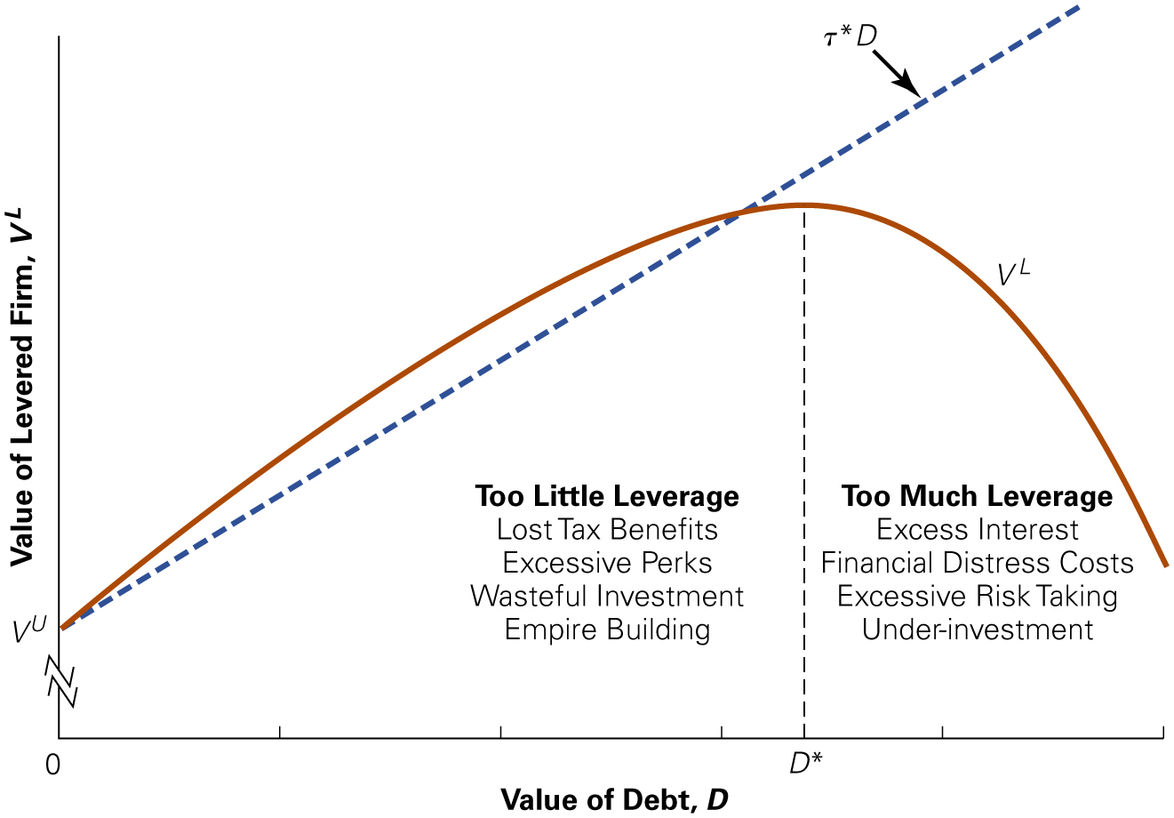
Figure 2
Optimal Leverage with Taxes, Financial Distress, and Agency Costs
Notes:
Long Description:
The details of the graph are as follows: The x-axis shows the days relative to equity issue announcement ranging from negative 500 to 100 in increments of 100. The y-axis shows the return relative to market in percent ranging from 0 to 60 in increments of 10. The graph shows that the curve starts at 3 percent at around minus 450 days and increases by 47 percent till the day of announcement (0) and on the same day drops 3 percent and remains almost the same till 100 days.

Slide 105
The Optimal Debt Level (1 of 2)
R&D-Intensive Firms
  Firms with high R&D costs and future growth opportunities typically maintain low debt levels
  These firms tend to have low current free cash flows and risky business strategies

Slide 106
The Optimal Debt Level (2 of 2)
Low-Growth, Mature Firms
  Mature, low-growth firms with stable cash flows and tangible assets often carry a high-debt load
  These firms tend to have high free cash flows with few good investment opportunities

Slide 107
Chapter Quiz (1 of 3)
Does the risk of default reduce the value of the firm?
If a firm files for bankruptcy under Chapter 11 of the bankruptcy code, which party gets the first opportunity to propose a plan for the firm’s reorganization?
Why are the losses of debt holders whose claims are not fully repaid not a cost of financial distress, whereas the loss of customers who fear the firm will stop honoring warranties is?

Slide 108
Chapter Quiz (2 of 3)
True or False: If bankruptcy costs are only incurred once the firm is in bankruptcy and its equity is worthless, then these costs will not affect the initial value of the firm.
What is the “Tradeoff” in the Tradeoff theory?
Why do firms have an incentive to both take excessive risk and underinvest when they are in financial distress?

Slide 109
Chapter Quiz (3 of 3)
Why would debt holders desire covenants that restrict the firm’s ability to pay dividends, and why might shareholders also benefit from this restriction?
In what ways might managers benefit by overspending on acquisitions?
Describe how the management entrenchment can affect the value of the firm.

